Slide 1

Intro to VR – Hello VR!
By: Jeremy nIELSON

Slide 2
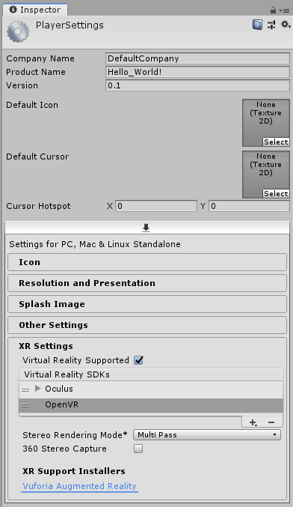
VR Project Settings
Player settings must be modified
File > Build Settings > Player Settings
In Inspector, Open XR Settings
Make sure OpenVR is selecte. If not, press plus to add them
If your consoles states OpenVR does not exist, remove the SDK and add it again in this menu
If you want to use Oculus specifically, add that SDK now

Slide 3
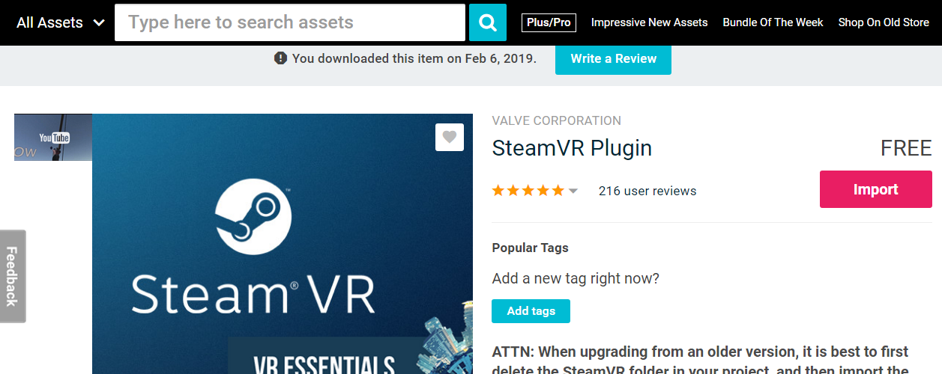
SteamVR Plugin
Go to the Asset Store and search “SteamVR Plugin”
Install and Import all assets

Slide 4
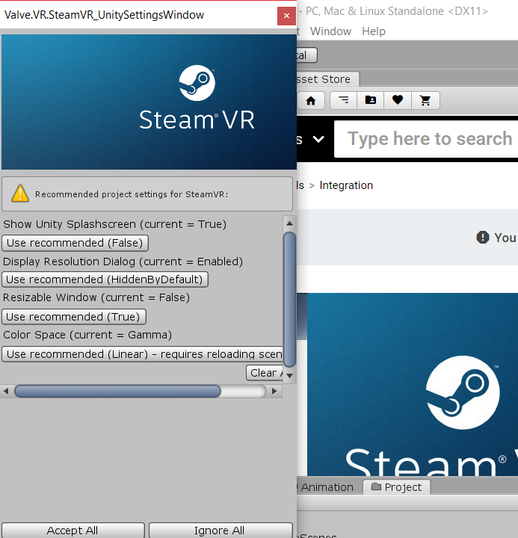
Steam VR Popup
When playing with the plugin, this may pop up with various recommended options.
Press Accept All

Slide 5
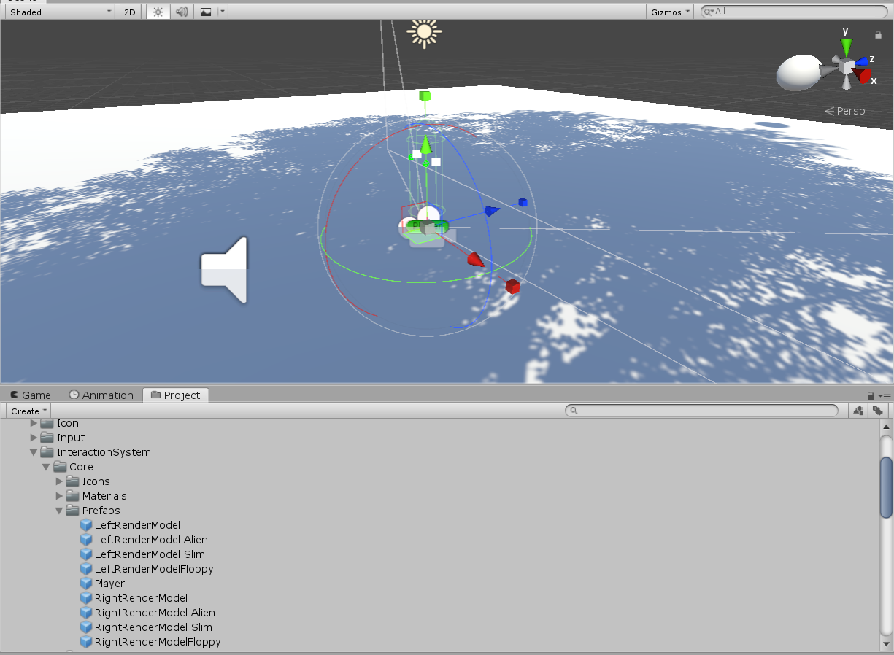
VR Player Controller
Remove The FPSController from before
Search for Player in projects, or go to SteamVR > InteractionSystem > Core > Prefabs > Player
Drag it onto the scene
Alternatively, if you want to not use SteamVR, Drag a camera object into the world and set the Y position to floor level and play!

Slide 6
Test the game
If you press play, SteamVR should load up and begin to boot.
You will most likely see a pop up saying your controllers are not bound
If ignored, you can get in game but cannot see the controllers

Slide 7
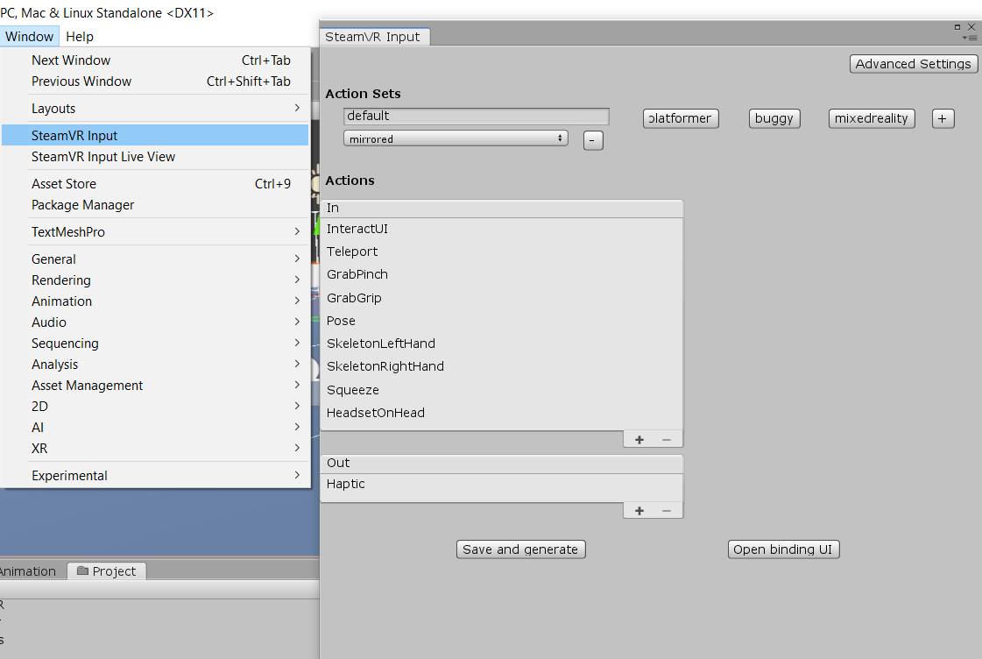
Create Steam Input
Go to Window > SteamVR Input.
This window will appear
Stick with the default for now
Press “Save and Generate”

Slide 8
Test the game again!
This time, playing the game your VR headset should operate as you’d expect
The controller models will render in game!
Future tutorials will detail setting up movement and interactions

